Slide 1
The Good, the Bad, and The Ugly
of
Game Development

Slide 2
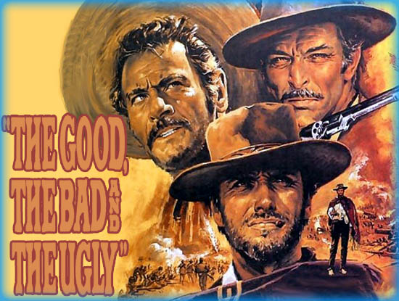
The Path
The Movie
As it related to my talk
The good, the bad, and the ugly of:
Being an Indie Developer
Being a part of:
A privately-owned small publisher (SSI)
A Large publicly owned publisher (Software Toolworks -> Mindscape -> TLC -> Mattel)
One of EA’s Studios (Westwood)
THQ Volition & Koch Volition
Copyright MGM
Notes:
The movie is about these three men and the different paths they take in an effort to find civil war gold, my talk is kinda the same. We also search for our gold, whether its financial, or social success or a family or business.
I have worked on a huge number of games in one way or another and I thought I would use my journey from company to company and game to game to describe my views on the good, bad, and ugly parts of Game Development and the Industry. (DISCLAIMER – I WAS in MGT my whole career so its from that perspective)
But First I thought I would give you a little background information.

Slide 3
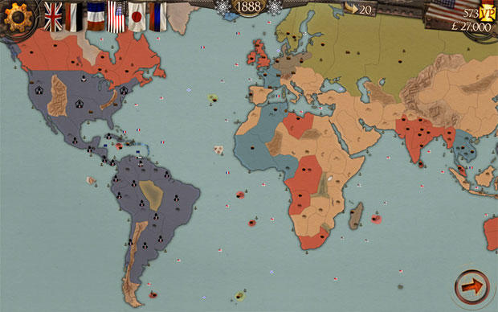
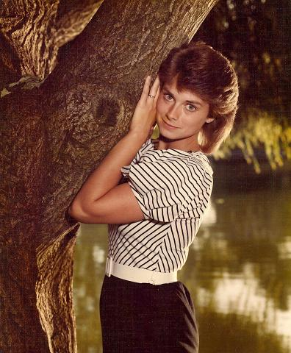
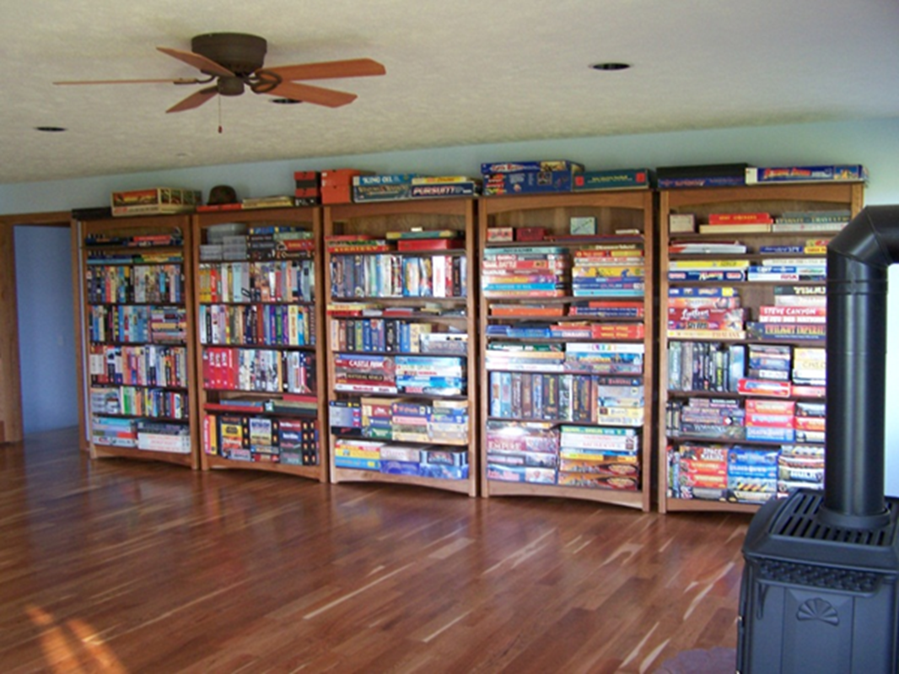
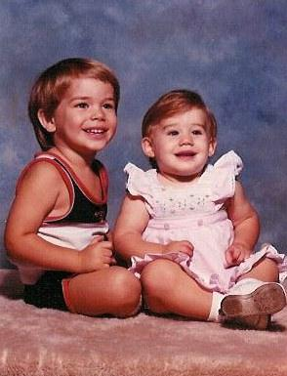
My Background
Before Video games
My Family
My first design
Notes:
Total Game freak. <Show Game Room>
Old School wargamer from age of 9. I played wargames by myself but other games with friends.
Yes, even though I was a super hard-core board gamer, I did have friends, even met this lovely lady <show Wife> and had 2 kids <Show Kids>. I mention them because they are important in the rest of my journey.
My first game design was a board game <Show Map>, a complicated version of Risk that I could play with friends while I worked the night shift at a hotel during college.

Slide 4
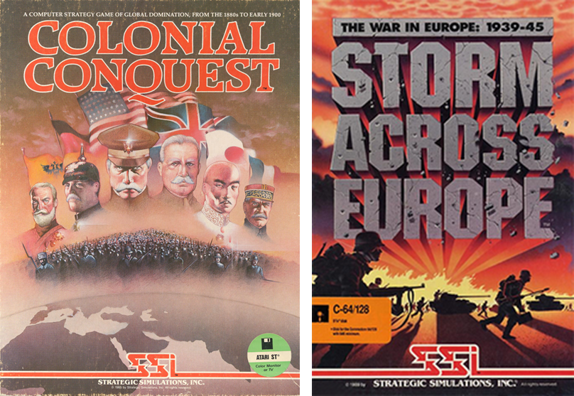
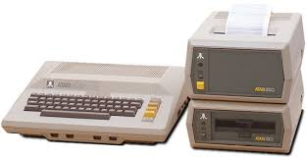
Indie Developer
First PC was an Atari 800 with 24K (1980)
All in, it cost me over $2500
Cassette tape drive
Extra 16K of ram
Printer
Languages
Self Taught Programmer
Took a few years before I began my 1st shipped game, based on my board game design.
Notes:
I graduated in the late 70s and didn’t even consider a career in the games business, mostly because there weren’t PCs at that time, then in the early 80s the Apple II, C64 and Atari 800 all came out and I became an indie developer. Of course, I kept my day job as a Med Tech in a Hospital…
I taught myself to program 6420 assembly language, wrote some edutainment and a side scroller to learn the process. Then I decided to do a real game.
Fortunately, I didn’t have a design problem because I had that board game design I created in college. <Show Games>
I created the game on the left and got it published in 1985, started a 2nd game and so I was an indie developer for quite a while, until 1989. Let’s talk about the good, bad and ugly side.

Slide 5

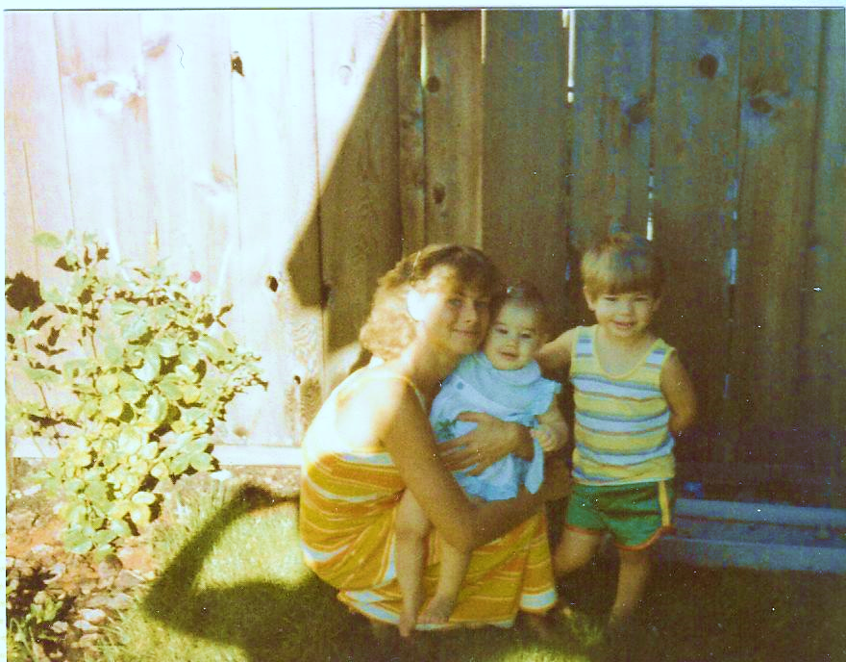
Indie Developer: The G, B, & the U
The Good:
Creative control
Independence
Passion (though passion is a trap)
The Bad:
Often associated with a lack of discipline
Productivity
Missing goals (didn’t really have milestones)
Design as you go
Most indie platforms area saturated
The Ugly:
I continued to work full time
The amount of work required to make it mean pennies/hour
The big ugly was the price paid by my wife and kids
Notes:
The Good:
Creative control
Independence
Passion (though passion is a trap) <Show Bad>
The Bad:
Often associated with a lack of discipline
Productivity: I personally couldn’t program with consistent productivity
Missing goals (didn’t really have milestones)
Design as you go
Most indie platforms area saturated (900K on Istore, 350K on Google (was 600K last Oct but they cleaned out the duplicates)
The Ugly:
I continued to work full time while working 8+ hours a day <Show Pennies>
The amount of work required to make it mean pennies/hour <Show Family>
The big ugly was the price paid by my wife and kids
For me I worked a day job and then another 8 hours on most days just learning how to program and create my first game. Probably made pennies per hour. The real price was paid by my wife and kids who suffered with my mental absence for more than a few years. It was tough. That and the inability to be productive on a schedule kept me from starting a studio. My Indie development combined with my management experience got me in the door at SSI (Strategic Simulations Inc) as the Manager of Contract Development and QA.

Slide 6
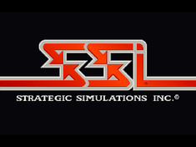
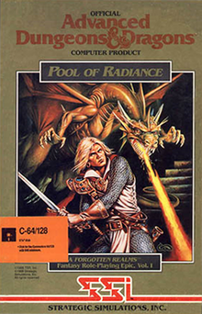
Small Privately-Owned Publisher
Everywhere I worked most folks were amazing
Hardworking
Creative
Brilliant in many cases
Passionate
Notes:
My Indie development combined with my management experience got me in the door at SSI (Strategic Simulations Inc) as the Manager of Contract Development and QA.
SSI was a small privately-owned publisher that had started as a wargame company (they published my games) and they grew because they got the TSR AD&D and D&D license.
<Show Game> The first game in the License was Pool of Radiance and it was one of the biggest sellers of that year with over 250K sold (yeah 250K).
For me I worked a day job and then another 8 hours on most days just learning how to program and create my first game. Probably made pennies per hour. The real price was paid by my wife and kids who suffered with my mental absence for more than a few years. It was tough. That and the inability to be productive on a schedule kept me from starting a studio. My Indie development combined with my management experience got me in the door at SSI (Strategic Simulations Inc) as the Manager of Contract Development and QA.

Slide 7

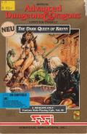
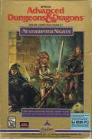
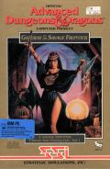

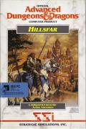
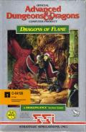
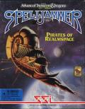
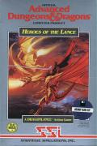
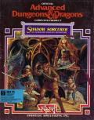
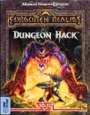
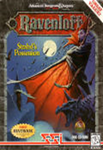
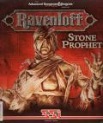
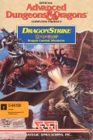
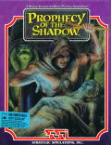
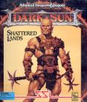
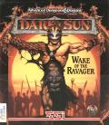
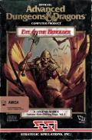
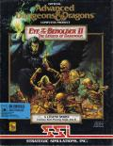
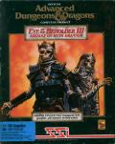


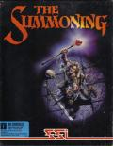
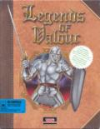



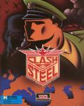




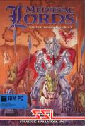


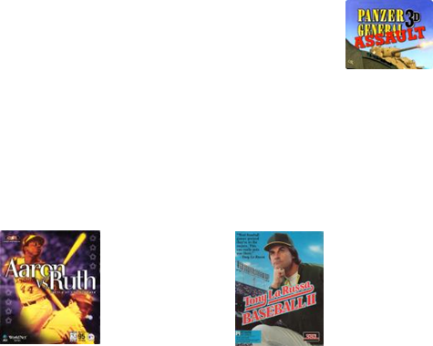
Small Privately-Owned Publisher (SSI)
TSR D&D IP: RPG, Action, Flight Simulator & the first Graphical MMO
RPG
Abstract Strategy
RTS
Wargame
Strategy
Sports
Notes:
I did a lot of games there. Most of them were externally developed. Since it was privately owned, we made payroll by shipping games, some weren’t that good. External was great though, made me focus on the production process and design input.
Did every conceivable project and studio management role there from CTO to Exec. Producer to Director and SR VP.
Couple of my favorites, I produced the first Graphical MMO (Neverwinter Nights on AOL at $6.00 an hour….)
Eye of the Beholder Series: Westwood project that went 1st person
For me I worked a day job and then another 8 hours on most days just learning how to program and create my first game. Probably made pennies per hour. The real price was paid by my wife and kids who suffered with my mental absence for more than a few years. It was tough. That and the inability to be productive on a schedule kept me from starting a studio. My Indie development combined with my management experience got me in the door at SSI (Strategic Simulations Inc) as the Manager of Contract Development and QA.

Slide 8

Small Privately-Owned Publisher (SSI)
TSR D&D IP: RPG, Action, Flight Simulator & the first Graphical MMO
RPG
Abstract Strategy
RTS
Wargame
Strategy
Sports
Notes:
I did a lot of games there. Did every conceivable project and studio management role there from CTO to Exec. Producer to Director and SR VP.
Couple of my favorites, I produced the first Graphical MMO (Neverwinter Nights on AOL at $6.00 an hour….)
Eye of the Beholder Series: Westwood project that went 1st person
For me I worked a day job and then another 8 hours on most days just learning how to program and create my first game. Probably made pennies per hour. The real price was paid by my wife and kids who suffered with my mental absence for more than a few years. It was tough. That and the inability to be productive on a schedule kept me from starting a studio. My Indie development combined with my management experience got me in the door at SSI (Strategic Simulations Inc) as the Manager of Contract Development and QA.

Slide 9
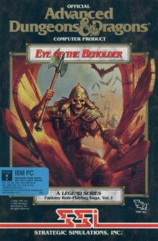
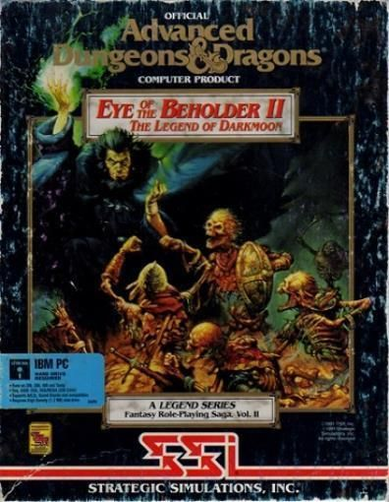
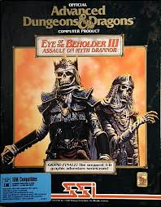
Small Privately-Owned Publisher (SSI)
IP
TSR D&D IP: RPG, Action, Flight Simulator & the first Graphical MMO
RPG
Abstract Strategy
RTS
Wargame
Strategy
Sports
Notes:
I did a lot of games there. Did every conceivable project and studio management role there from CTO to Exec. Producer to Director and SR VP.
Couple of my favorites, I produced the first Graphical MMO (Neverwinter Nights on AOL at $6.00 an hour….)
Eye of the Beholder Series: Westwood project that went 1st person
For me I worked a day job and then another 8 hours on most days just learning how to program and create my first game. Probably made pennies per hour. The real price was paid by my wife and kids who suffered with my mental absence for more than a few years. It was tough. That and the inability to be productive on a schedule kept me from starting a studio. My Indie development combined with my management experience got me in the door at SSI (Strategic Simulations Inc) as the Manager of Contract Development and QA.

Slide 10


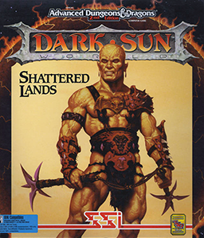
Good, Bad and Ugly: Small Privately-Owned Publisher
Good:
Focus on Production Process (wear many hats)
Made a lot of industry connections
Community
Meritocracy
Bad:
Couldn’t afford to hire the best
No room for failure at a private company
And yet we failed with a new engine
My first lesson that tech takes longer than planned
Ugly:
First taste of Politics
Not terrible but little empires
The failure of Dark Sun led to a layoff, my first
Notes:
Good: Learned the ropes of production because I got to do so many different games in different genres with different audience expectations.. Also the hard core wargamer in me learned that simplicity sells (Panzer General).
Industry connections, working with so many external groups along with hiring over the years gave me a lot of industry connections. As a side note NEVER burn your bridges, never leave a company in a bad way… If you can, ship the game you were working on if possible…, it matters.
Meritocracy meant lots of room for advancement, lots of product to make (gotta ship product to make payroll).
Bad: Couldn’t hire the best, couldn’t afford it, hired less experienced but passionate folks. That was an issue as they got bored and didn’t finish. 80% ers. The new engine we were creating took longer than planned (this is a running theme in my time in video game) and when shipped a game with the new engine
<Dark Sun> it needed more work and it was not successful enough.
Ugly:
My first taste of Politics. Not as bad as some places I have seen but my boss (head of R&D) wouldn’t even let a marketing person in the game dev area. People built little power centers and it was sad to see. Experiences to come showed me that this was mild. I developed a strong disgust for politics.
Led to a layoff, I did the laying off, not a great experience, unfortunately you have a 90% change of being laid off in the first 5 years and the avg time in a studio is around 4 yrs now..
The owner didn’t want to risk his family’s investment, so he sold…
For me I worked a day job and then another 8 hours on most days just learning how to program and create my first game. Probably made pennies per hour. The real price was paid by my wife and kids who suffered with my mental absence for more than a few years. It was tough. That and the inability to be productive on a schedule kept me from starting a studio. My Indie development combined with my management experience got me in the door at SSI (Strategic Simulations Inc) as the Manager of Contract Development and QA.

Slide 11
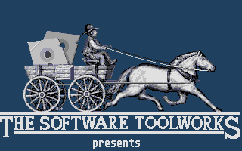

Mid-Sized Publicly Owned Publisher(s)
$
$
Notes:
We got bought by Software Toolworks who bought Mindscape and took the name. They were much bigger and publicly traded. They made productivity, educational and game software.
For me I worked a day job and then another 8 hours on most days just learning how to program and create my first game. Probably made pennies per hour. The real price was paid by my wife and kids who suffered with my mental absence for more than a few years. It was tough. That and the inability to be productive on a schedule kept me from starting a studio. My Indie development combined with my management experience got me in the door at SSI (Strategic Simulations Inc) as the Manager of Contract Development and QA.

Slide 12


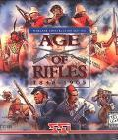

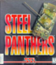






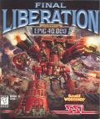


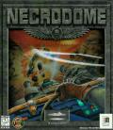

Mid-Sized Publicly Owned Publisher (Buncha names)
Strategy and Wargames
Space Sim
RTS
Vehicular Combat
Sports
Notes:
This is when I started to see things as what I can base and bets. Mindscape edutainment and productivity groups made things like Chessmaster and Mavis Beacon Teaches Typing as well as a large number of kid's education games. This was Mindscape’s base and they could make bets on games.
Unfortunately the market for edutainment started to die and my role changed. I started helping shut divisions down, we bought Broderbund and killed most of their projects, I was given sports and I had to close it down.
For me I worked a day job and then another 8 hours on most days just learning how to program and create my first game. Probably made pennies per hour. The real price was paid by my wife and kids who suffered with my mental absence for more than a few years. It was tough. That and the inability to be productive on a schedule kept me from starting a studio. My Indie development combined with my management experience got me in the door at SSI (Strategic Simulations Inc) as the Manager of Contract Development and QA.

Slide 13
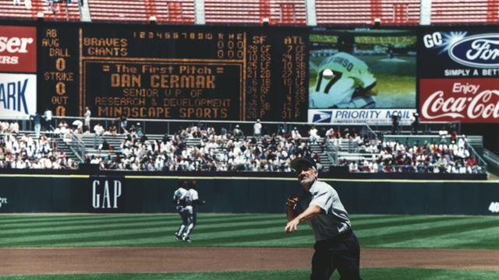

Slide 14




Mid-Sized Publicly Owned Publisher(s)
$
$
$
$
$
Notes:
While all this was going on, we got bought again, and then again and then again…. The last one was not a good situation, TLC had flooded the market with edutainment product and showed their books to Mattel, they did no due diligence and ending up paying over 4 Billion for a company that was worth maybe 900K. <show the bomb> Mattel nearly imploded and they ended up laying off a bunch of folks and selling Assets and IPs for almost nothing. (200-300M)
For me I worked a day job and then another 8 hours on most days just learning how to program and create my first game. Probably made pennies per hour. The real price was paid by my wife and kids who suffered with my mental absence for more than a few years. It was tough. That and the inability to be productive on a schedule kept me from starting a studio. My Indie development combined with my management experience got me in the door at SSI (Strategic Simulations Inc) as the Manager of Contract Development and QA.

Slide 15




Mid-Sized Publicly Owned Publisher: G, B & U
Good:
Career Development
Publicly owned - more money!
Games managed and produced as part of genres
Investment in teams
Games marketed at a higher level
Bad:
New management means new methods
Usually just more work as you prove yourself
It was no longer a community(too big), it was a job
Becomes spreadsheet driven, employees become numbers
Publicly traded meant being under a microscope
Ugly:
More people mean more politics
Notes:
Good, Bad and Ugly of a mid-sized publicly traded company and being acquired by same…
Good: Career Development, more money!, investment in teams, games as part of genres and games marketed at a higher level (got to throw out a first pitch)
Bad: Changing mgt multiple times means new methods; means being put in the back seat as an acquisition. The size meant we lost the community feel. Publicly traded meant we got external pressure because we had to prove ourselves every quarter
Ugly: Having multiple cost centers means competition and sometimes lack of funding
I was one of the layoffs…..
For me I worked a day job and then another 8 hours on most days just learning how to program and create my first game. Probably made pennies per hour. The real price was paid by my wife and kids who suffered with my mental absence for more than a few years. It was tough. That and the inability to be productive on a schedule kept me from starting a studio. My Indie development combined with my management experience got me in the door at SSI (Strategic Simulations Inc) as the Manager of Contract Development and QA.

Slide 16
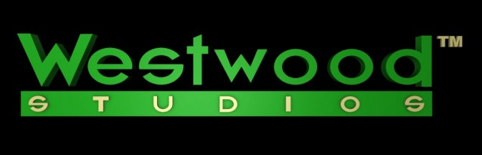
Big Studio, Huge Publisher (EA)
Notes:
My connections I had developed at SSI led me to Westwood, they had started as a port studio and ended up creating the RTS genre and hit it big. They were the creators of the Dune, Red Alert and Command & Conquer games. By the time I got to Vegas, Westwood was an EA owned studio.
This was my first experience at a studio that was not part of a publisher and I learned a lot of things about what its like to be owned from a distance. If EA had stayed at a distance it would have been fine. Instead, EA taught me a lot about what NOT to do….
The good, bad and ugly part of being in at Westwood will focus mostly on the bad and ugly unfortunately.
For me I worked a day job and then another 8 hours on most days just learning how to program and create my first game. Probably made pennies per hour. The real price was paid by my wife and kids who suffered with my mental absence for more than a few years. It was tough. That and the inability to be productive on a schedule kept me from starting a studio. My Indie development combined with my management experience got me in the door at SSI (Strategic Simulations Inc) as the Manager of Contract Development and QA.

Slide 17


Big Studio, Huge Publisher (EA): The Good
EA’s & Westwood’s Good:
Deeper Pockets
Professional Organization
Career path with clearly defined job descriptions
Company Bonuses
IP (Intellectual Property)
Experience (knowledge of how to do the job)
Talented group (smart and creative)
Access to world class designers
Great People (mostly)
Notes:
There is good: I got exposure to what EA’s resources could bring to the table. They took the career path a step further with clearly defined Job Descriptions
They built their Base off of big IPs (things like Harry Potter, John Madden, FIFA) and some amazing people They had world class designers that had written design processes (Wil Wright, Sid Meier, Richard Garriott, Peter Molineux).
Great folks in every area (for the most part)
For me I worked a day job and then another 8 hours on most days just learning how to program and create my first game. Probably made pennies per hour. The real price was paid by my wife and kids who suffered with my mental absence for more than a few years. It was tough. That and the inability to be productive on a schedule kept me from starting a studio. My Indie development combined with my management experience got me in the door at SSI (Strategic Simulations Inc) as the Manager of Contract Development and QA.

Slide 18
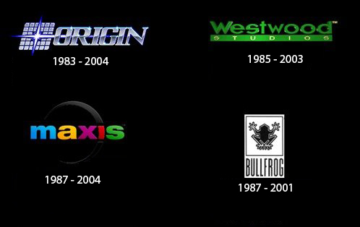

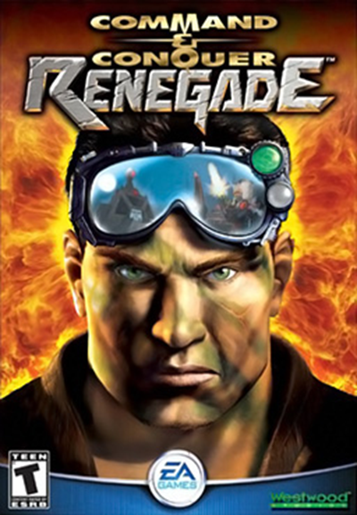



Big Studio, Huge Publisher (EA): The Bad
EA & Westwood’s Bad
Broken on Arrival
The Game : Renegade
The Studio
EA’s Leadership Style
Demos
Culture
Politics
Endoftheamericandream.com
Notes:
The Bad: As successful as Westwood was, I came expecting they would be at another level in process and planning, I found a near dead project, a broken studio, and EA.
Project: Renegade, good idea from an IP standpoint, but Seagull management ruined it.
Studio: I thought I heading back to a community and it was nothing like that.
EA demanded a demo each quarter and to meet their expectations we had to spend a full month creating the demo each quarter, image that. They brought great things to the company, but they also tried to impose their culture and dev. Methods. Imposed a Creative Director from on me without my asking, Great guy but had a new direction every day. I ended up shielding the team from him. Some were helpful, most were not.
You can see from the list of great studios that died during this time that it was an ineffective process.
Happy to say they now support the culture inside studios, in fact the person in charge of studios nowadays was the Marketing VP at Westwood when I was there, and she is an amazing person. They still close studios but it’s based on success/failure and the studio cultures are left alone.
For me I worked a day job and then another 8 hours on most days just learning how to program and create my first game. Probably made pennies per hour. The real price was paid by my wife and kids who suffered with my mental absence for more than a few years. It was tough. That and the inability to be productive on a schedule kept me from starting a studio. My Indie development combined with my management experience got me in the door at SSI (Strategic Simulations Inc) as the Manager of Contract Development and QA.

Slide 19

Big Studio, Huge Publisher (EA): Westwood Ugly
The Sacred Cow
Notes:
Ugly: Funny thing is the studio had its own ugly cultural issues. They had sacred cows. Guys that contributed at a high level at one point in the past but had become rule breakers or just useless (one guy had his own business running in his office and another lied on his timecard every week). They wouldn’t let me fire them…. Bad for studio morale. At one point I did fire a QA tester for attendance and focus issues only to find out he was a close friend of the owner and I was dragged on the carpet for it.
For me I worked a day job and then another 8 hours on most days just learning how to program and create my first game. Probably made pennies per hour. The real price was paid by my wife and kids who suffered with my mental absence for more than a few years. It was tough. That and the inability to be productive on a schedule kept me from starting a studio. My Indie development combined with my management experience got me in the door at SSI (Strategic Simulations Inc) as the Manager of Contract Development and QA.

Slide 20
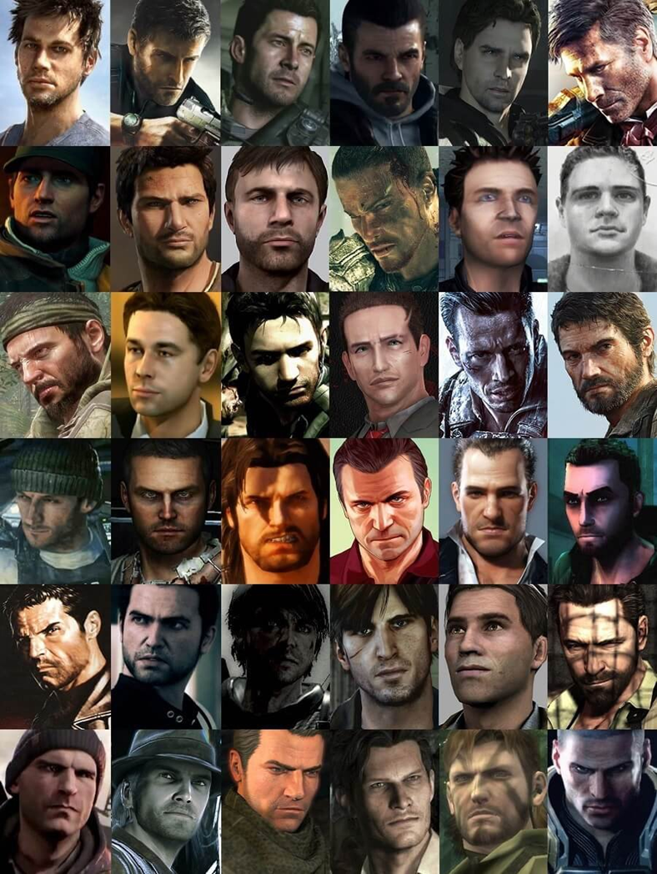
Big Studio, Huge Publisher (EA): EA &Westwood Ugly
Diversity in Games Issue
Main Character, now vs then
Notes:
Another interesting and ugly issue came up while working on the project. It is related to the lack of diversity in video games. When I started in the business, women were a key part of it. (Roberta Williams, Anne Westfall) I recently saw this (a picture of the heads of recent video game main characters). Amazing that they are mostly military style white guys. What is more amazing is I sent a similar picture out to my team in 2000 saying, can’t we do better than this. We tried to get a black main character in the game, and it was shot down quickly.
For me I worked a day job and then another 8 hours on most days just learning how to program and create my first game. Probably made pennies per hour. The real price was paid by my wife and kids who suffered with my mental absence for more than a few years. It was tough. That and the inability to be productive on a schedule kept me from starting a studio. My Indie development combined with my management experience got me in the door at SSI (Strategic Simulations Inc) as the Manager of Contract Development and QA.

Slide 21

Big Publisher (THQ)
Base was IP Driven
WWE (wrestling)
Kids (Nickelodeon and others)
Publicly Traded, in a growth spurt
Notes:
Renegade did not perform well, and I was let go (too many producers as they now trying to do MMOs). My first impression of THQ was an ugly one. I interviewed for a Director position at THQ and was told by the VP of Development that an offer was forthcoming on Monday. I did not hear on Monday or Tuesday. The ugly part came on Wednesday when I called and found out that the VP had been fired over the weekend for inappropriate behavior (aka sexual harassment). I was then invited to interview for his position, went great until I met the new Head of Studios and he said he had someone else in mind….
For me I worked a day job and then another 8 hours on most days just learning how to program and create my first game. Probably made pennies per hour. The real price was paid by my wife and kids who suffered with my mental absence for more than a few years. It was tough. That and the inability to be productive on a schedule kept me from starting a studio. My Indie development combined with my management experience got me in the door at SSI (Strategic Simulations Inc) as the Manager of Contract Development and QA.

Slide 22

Volition, Big Publisher (THQ)
THQ was on a studio buying spree, bought Volition
Came in as VP of Design/Production
Great Boss
I did some things that were Good, Bad, and Ugly
Notes:
I kept looking and landed at Volition, which was owned by THQ. I found out that the person I replaced was the person that the studio head wanted as VP of Development in LA (see, small industry). A year after I started corporate called and asked me to come out and fill the VP position, because the guy from Volition left, I refused. Volition was the place for me.
I came in as VP and my boss impressed the heck out of me. He was down to earth, honest, direct and he engendered respect. I found over the course of my career that a company’s culture is a reflection of the leader. Examples include EA, Westwood, look at Riot games recently. its something to think about as you look for a place to work.
I found that sense of community again.
I was given the freedom to implement things as I saw fit. Leaning on what I saw from EA/Westood, I did quite a few new things, some good, some bad, some ugly and as the leader I have to own the bad/ugly ones..
For me I worked a day job and then another 8 hours on most days just learning how to program and create my first game. Probably made pennies per hour. The real price was paid by my wife and kids who suffered with my mental absence for more than a few years. It was tough. That and the inability to be productive on a schedule kept me from starting a studio. My Indie development combined with my management experience got me in the door at SSI (Strategic Simulations Inc) as the Manager of Contract Development and QA.

Slide 23
Volition, Big Publisher (THQ): Good
Installed HR
Career Path for every position
Job descriptions
Standardized pay ranges
Performance expectations
Setup a new studio structure
Setup a new project structure
With rotating leadership roles
Notes:
On the good side I created a career path for every position with standard pay ranges, job descriptions and performance expectations, installed HR, setup a studio and project structure with a rotating leadership group.
I must start talking about Good, Bad and Ugly in terms of specific projects now. The first example is Saints Row.
For me I worked a day job and then another 8 hours on most days just learning how to program and create my first game. Probably made pennies per hour. The real price was paid by my wife and kids who suffered with my mental absence for more than a few years. It was tough. That and the inability to be productive on a schedule kept me from starting a studio. My Indie development combined with my management experience got me in the door at SSI (Strategic Simulations Inc) as the Manager of Contract Development and QA.

Slide 24
Volition, Big Publisher (THQ): Bad
Threw too many changes at them too quickly
All those studio changes and then project changes
New Genre
New Platform
New Tech
Grew the company too fast
100+ people in a year
Notes:
We didn’t have a direction when I arrived. We dove head long into a new Genre (open world) with a new project structure on a new platform, while growing the company by 100+ folks in a year.
For me I worked a day job and then another 8 hours on most days just learning how to program and create my first game. Probably made pennies per hour. The real price was paid by my wife and kids who suffered with my mental absence for more than a few years. It was tough. That and the inability to be productive on a schedule kept me from starting a studio. My Indie development combined with my management experience got me in the door at SSI (Strategic Simulations Inc) as the Manager of Contract Development and QA.

Slide 25
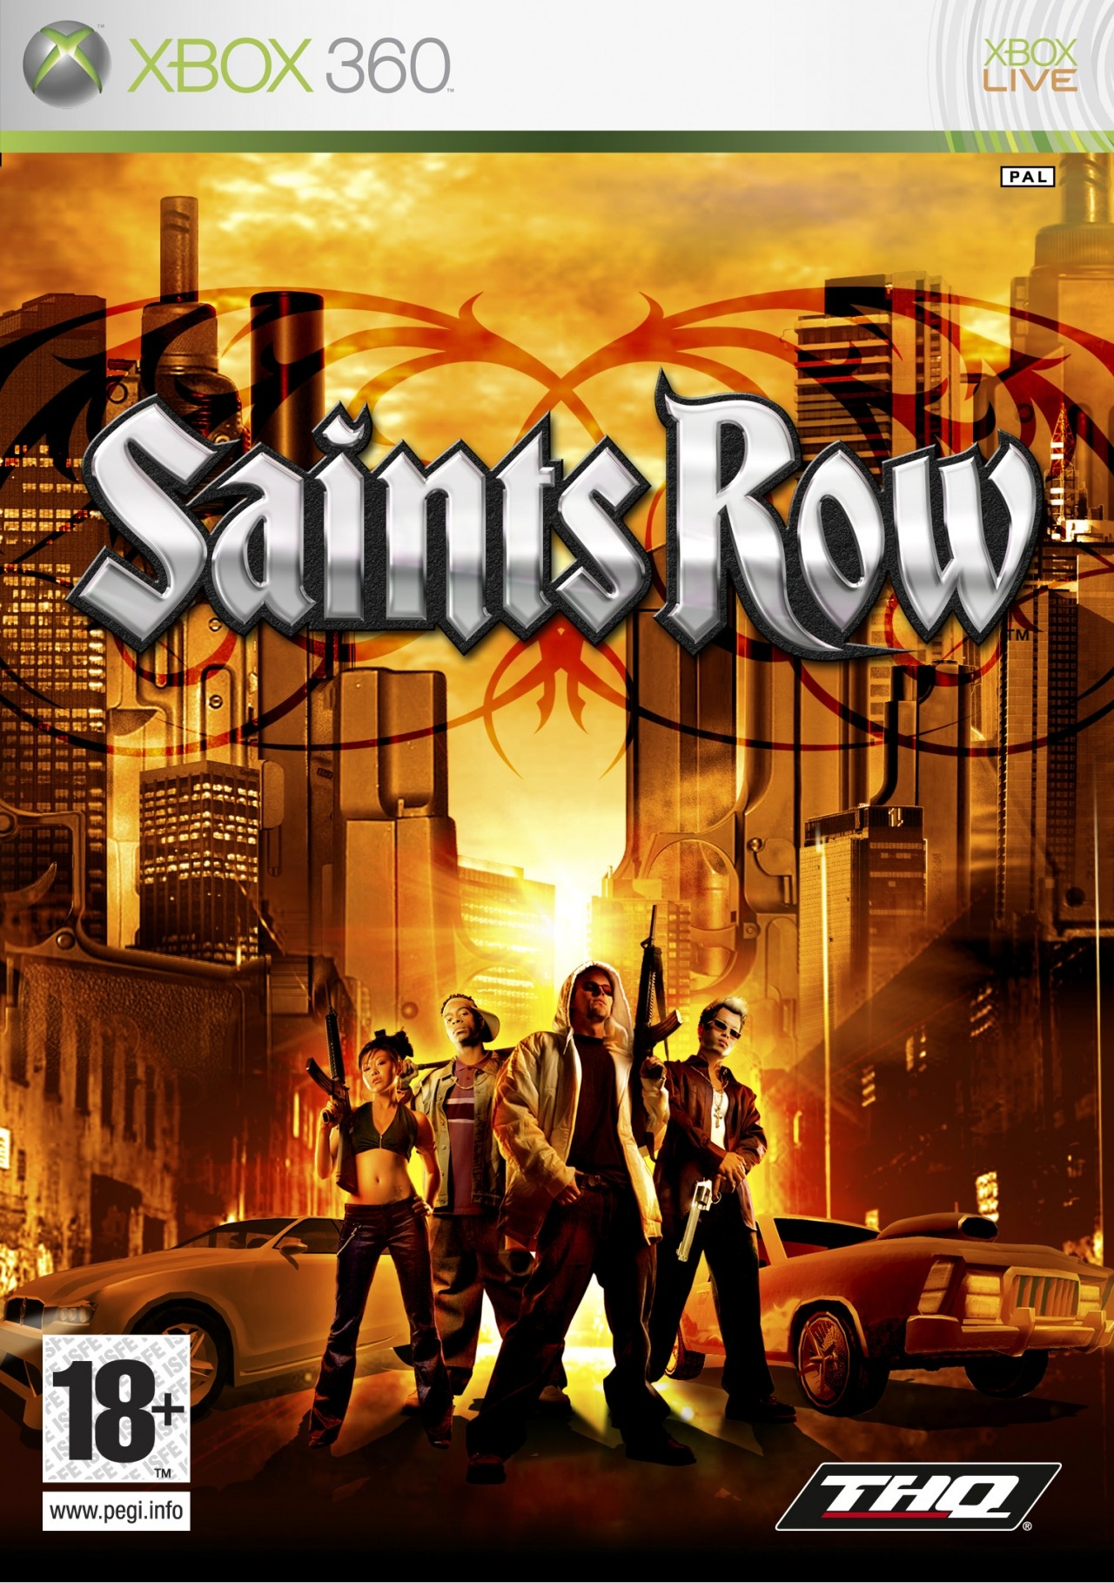
Volition, Big Publisher (THQ): Saints Row Ugly
What we did building SR wasn’t just ugly
It was painful
It was eye opening
It changed the way we made games
Notes:
Growing the company that fast meant I had to implement an in-depth project management system on the project. Being in the middle of Illinois meant most folks were new to making games, so we felt we needed to direct them at a more detailed level, turned out to be an ugly level, at times we tracked them down to 15-minute increments. We were a year late (mostly due to tech delays). It led to what was described, by some members of the team, as a death march.
Lesson learned was you can’t manage productivity. Schedules and budgets are decision making tools and not the means by which you drive a project to completion.
For me I worked a day job and then another 8 hours on most days just learning how to program and create my first game. Probably made pennies per hour. The real price was paid by my wife and kids who suffered with my mental absence for more than a few years. It was tough. That and the inability to be productive on a schedule kept me from starting a studio. My Indie development combined with my management experience got me in the door at SSI (Strategic Simulations Inc) as the Manager of Contract Development and QA.

Slide 26
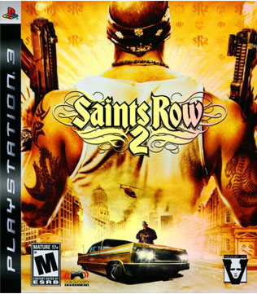
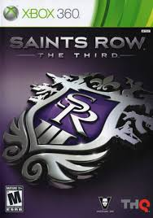

Volition: Saints Row Sequels, Yea!!!
Saints Row the Third, big seller
Found our strength
Focused on Density, not size
Good:
Brought in managers to support folks
Treated the company as adults
FWE
Bad:
Communication
Meetings
Ugly:
Lack of Long-term IP planning
Notes:
Saints Row was a hit because we were the first open world game on console. With that success we found another good thing, sequels, at least it was good for the studio. Lots of people think that sequels are boring but as a studio head I embraced them since it meant that we could keep doing what we loved. Our 3rd game in the series was a big hit, selling millions and ranking in the top ten sellers for the year. This meant that the game sales continued at full price for over 6 months and led to the most profitable product in THQ history. The series is over 30 million by now and in the process, we learned valuable lessons:
Good: We found real managers to manage people not people good at specific disciplines. By SR3 we had instituted Flex time (we called it FWE) with the main requirement that you get your work done and you be in the office for 2 hours a day during a certain window for meetings and other communication.
Bad: Communication is hard in a big company; people often hear what they want to hear. Meetings are the bane of productivity. There are better ways I have been told, but we never found one. We kept our sub-teams small but everyone of them felt they needed to have a representative in every meeting, it usually ended up being the most senior, productive, person…..
Ugly: We didn’t have any long-term planning. Left us in a quandary of where to go as an IP after we allow you to the become emperor of the known galaxy.
For me I worked a day job and then another 8 hours on most days just learning how to program and create my first game. Probably made pennies per hour. The real price was paid by my wife and kids who suffered with my mental absence for more than a few years. It was tough. That and the inability to be productive on a schedule kept me from starting a studio. My Indie development combined with my management experience got me in the door at SSI (Strategic Simulations Inc) as the Manager of Contract Development and QA.

Slide 27

Volition, Big Publisher (THQ): The big ugly
Bankruptcy
Notes:
Bankruptcy is really ugly. Publicly traced companies can sometimes forget they need profits. THQ failed after losing their base business (kid’s games and wrestling) and the not being able to replace that base. I ended up in Delaware watching the company being sold off in pieces waiting for Volition to hit the auction block. We were visited by many companies prior to the auction and we thought we would end up a WB studio, but they didn’t show. We ended up with Koch Media, the #1 software distributor in Europe.
For me I worked a day job and then another 8 hours on most days just learning how to program and create my first game. Probably made pennies per hour. The real price was paid by my wife and kids who suffered with my mental absence for more than a few years. It was tough. That and the inability to be productive on a schedule kept me from starting a studio. My Indie development combined with my management experience got me in the door at SSI (Strategic Simulations Inc) as the Manager of Contract Development and QA.

Slide 28

DSVolition, B Product Publisher: Koch
Tried to Remake SR (Agents of Mayhem)
Aggressive, forward-looking plan
Persistent world constantly growing, changing
32 cities, each with a focused style
Persistent changing environments & characters
Character focused
New methods to set project vision
New project structure
New engine
Overhang all of this was a Cultural Mismatch
Notes:
We thought we had a good plan for the future of the franchise.
Tried a new way to plan our games and IPs.
Tried a flatter project structure but it didn’t work, the people that were to implement the change were the people losing control and I got passive resistance, gave up on it.
Most open world companies have a proprietary game engine, we built one ourselves.
Its good to be owned by a company that knows games and understands studios. It can be ugly when you are owned buy a distribution company that lives by shaving pennies. We wanted to create an atmosphere amendable to productivity and creativity, It can be ugly when that butts into a ownership motivated by shaving pennies. Our culture was affected by budgeting issues that affected morale. It felt by EA but in a different way.
For me I worked a day job and then another 8 hours on most days just learning how to program and create my first game. Probably made pennies per hour. The real price was paid by my wife and kids who suffered with my mental absence for more than a few years. It was tough. That and the inability to be productive on a schedule kept me from starting a studio. My Indie development combined with my management experience got me in the door at SSI (Strategic Simulations Inc) as the Manager of Contract Development and QA.

Slide 29
DSVolition (Koch): G, B & U
Good:
Vision system worked
Engine turned out amazing
Bad:
Ran out of money (Koch wouldn’t continue)
Engine took too long and therefore cost too much
Sony wouldn’t support our plan anyway
Ugly:
Tried to pivot to a 3rd person action game, failed
Lost support from Marketing
Another round of layoffs, including myself
Notes:
Good:
Vision system worked, top down, accepted and understood by everyone
Engine turned out amazing, things that used to take 6 months could be built in a few days.
Bad:
Ran out of money (Koch wouldn’t continue)
Engine took too long and therefore cost too much
Sony wouldn’t support our plan anyway
Ugly:
Tried to pivot to a 3rd person action game, didn’t have enough time to do it right, it failed
Lost support from Marketing
Another round of layoffs, including myself
For me I worked a day job and then another 8 hours on most days just learning how to program and create my first game. Probably made pennies per hour. The real price was paid by my wife and kids who suffered with my mental absence for more than a few years. It was tough. That and the inability to be productive on a schedule kept me from starting a studio. My Indie development combined with my management experience got me in the door at SSI (Strategic Simulations Inc) as the Manager of Contract Development and QA.

Slide 30


Good, Bad and Ugly from the Highest Level
Good:
Biggest Entertainment Products in the world
Growth of the audience
GAMES, so many games
New Tech, means new adventures for developers
Bad:
AAA costs too much
Revenue generation methods (microtransactions)
Ugly:
We are a talking point for politicians
We don’t have our “stars”, studios rule
Alex Angove Whistleout
Notes:
Getting to the end of my journey but I thought I would give a round of G B & U in regard to the industry.
Good:
Biggest Entertainment Products in the world
Growth of the audience 250K to 100M for GTA
GAMES, so many games on so many platforms
New Platforms, means new adventures for developers, back to the wild, wild, west
Bad:
AAA costs too much, the numbers of them are dropping, With procedural generation, machine learning and AI advances it makes me wonder about the future of AAA studios..
We aren’t treated like music and movies, so we have microtransactions, the psychology of them is focused on taking advantage of our customer that it concerns me.
Ugly:
We don’t have our “stars’, studios rule. Didn’t used to be that way, where are the new Wil Wrights and Miyamotos
We are a “talking point” for politicians
For me I worked a day job and then another 8 hours on most days just learning how to program and create my first game. Probably made pennies per hour. The real price was paid by my wife and kids who suffered with my mental absence for more than a few years. It was tough. That and the inability to be productive on a schedule kept me from starting a studio. My Indie development combined with my management experience got me in the door at SSI (Strategic Simulations Inc) as the Manager of Contract Development and QA.

Slide 31

My Path
The journey has been amazing.
Notes:
I have been able to do what I love. There have been interesting twists and turns but I was lucky in that I could focus on the journey because I found my gold before the journey even began and she stuck with me the whole time. I hope you all have a glorious journey of your own.
For me I worked a day job and then another 8 hours on most days just learning how to program and create my first game. Probably made pennies per hour. The real price was paid by my wife and kids who suffered with my mental absence for more than a few years. It was tough. That and the inability to be productive on a schedule kept me from starting a studio. My Indie development combined with my management experience got me in the door at SSI (Strategic Simulations Inc) as the Manager of Contract Development and QA.

Slide 32
Ask Me Stuff

Slide 35


Volition: We had Two IPs: 1st: Red Faction Guerrilla
Smart for the Studio
Good:
Best Rated game we did
Tech, strong tools, an actual engine
Bad:
Design & destruction
Building the Tech, again
Lack of sales vs. cost of dev.
Ugly:
Impact on the studio
Notes:
We had a 2 IPs (Red Faction Guerrilla, a sci-fi game about a revolution on Mars against Earth, that was also a bundle of good, bad and ugly.
Good: Best rated game we did in my tenure. Technology was one of a kind (we built a true physics engine) Strong tools, a real engine Bad: The tech took 2 years longer than they said it would We built the team out before we had the tech, wasted a lot of money and learned a lesson. Ugly: It didn’t sell enough considering the delay’s impact on budget (we figured you had to sell 1M units for every $20M in budget). This had the owners (THQ) telling us we had to lay off half the team…. This led to something even uglier. In order to save the team we had to promise to bring in the sequel in 18 months instead of 24 months. This was bad but we quickly got to a vertical slice (it was a sequel) and we sent it to corporate for review. I got an email from the VP of Dev. asking me where the aliens were. We had built the sequel to be earth’s response to the revolution on Mars and there weren’t any aliens. I thought he was joking and two weeks later I got another email, “Did you think I was kidding, where are my aliens?”
Unfortunately, they didn’t change the timeline. We had to add aliens which delayed production about 3 months which means we had to change the game play to something we could create faster, a linear mission game, no longer an open world game which was our strength. It turned out to be one of the worst reviewed games in my tenure.
For me I worked a day job and then another 8 hours on most days just learning how to program and create my first game. Probably made pennies per hour. The real price was paid by my wife and kids who suffered with my mental absence for more than a few years. It was tough. That and the inability to be productive on a schedule kept me from starting a studio. My Indie development combined with my management experience got me in the door at SSI (Strategic Simulations Inc) as the Manager of Contract Development and QA.

Slide 36

Large Publicly Owned Publisher (Buncha names)
Strategy and Wargames
Space Sim
RTS
Vehicular Combat
Sports
Notes:
I did get to work on a crazy project: Aaron vs. Ruth. Image Hank Aaron’s team playing against the old timers like Babe Ruth. It was crazy and I learned a lot about doing IP contacts, I think we had 36 licenses to contract, and I thought working with TSR was hard. The good thing was marketing had money so we did big things, like having Aaron vs. Ruth sponsor a SF Giants (pro Baseball) game at Candlestick park, I got to throw out the first pitch ….
For me I worked a day job and then another 8 hours on most days just learning how to program and create my first game. Probably made pennies per hour. The real price was paid by my wife and kids who suffered with my mental absence for more than a few years. It was tough. That and the inability to be productive on a schedule kept me from starting a studio. My Indie development combined with my management experience got me in the door at SSI (Strategic Simulations Inc) as the Manager of Contract Development and QA.

